Slide 1
Flight price prediction
PS MANIKANTAVIJAYASRI NARASIMHANAIDU CHIKKALA

Slide 2
Introduction
Airline companies use complex algorithms to calculate flight prices given various conditions present at that particular time. These methods take financial, marketing, and various social factors into account to predict flight prices.
Now a days, the number of people using flights has increased significantly. It is difficult for airlines to maintain prices since prices change dynamically due to different conditions. That’s why we will try to use machine learning to solve this problem. This can help airlines by predicting what prices they can maintain. It can also help customers to predict future flight prices and plan their journey accordingly.

Slide 3


Data Source:
Source:- https://www.kaggle.com/datasets/jillanisofttech/flight-price-prediction-dataset
There are two files in that link Data_Train.xlsx and Test_set.xlsx.
The train dataset consists of 10,683 rows and 11 columns.
The test dataset has 2671 rows and 10 columns.
The test dataset doesn’t have price. So, Initially I worked with Train data file and then I used that to predict the price for the test data.

Slide 4
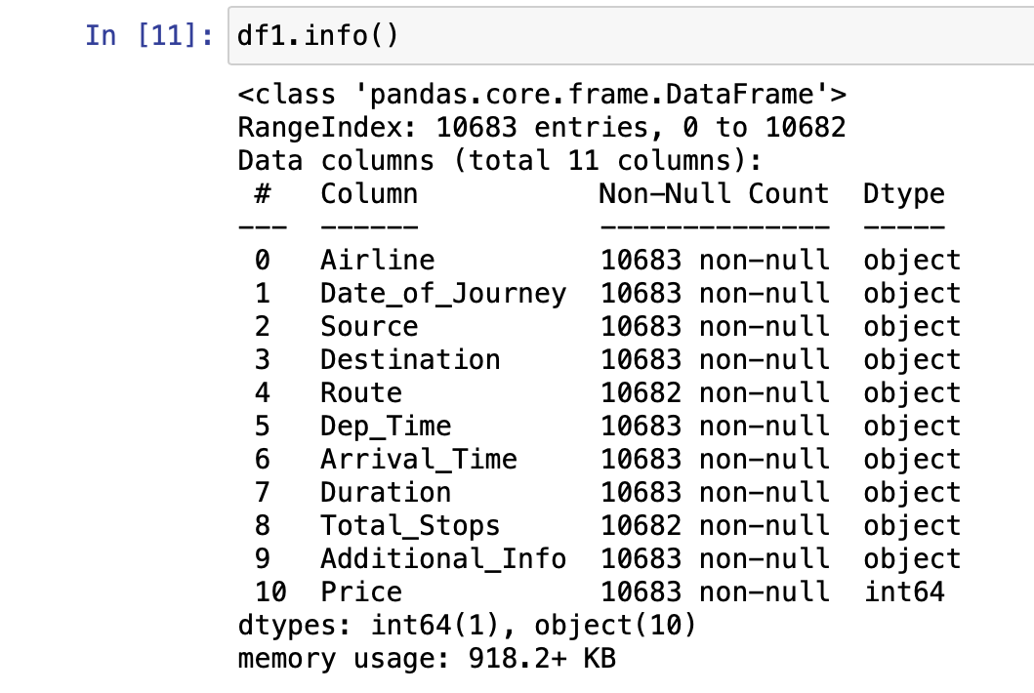
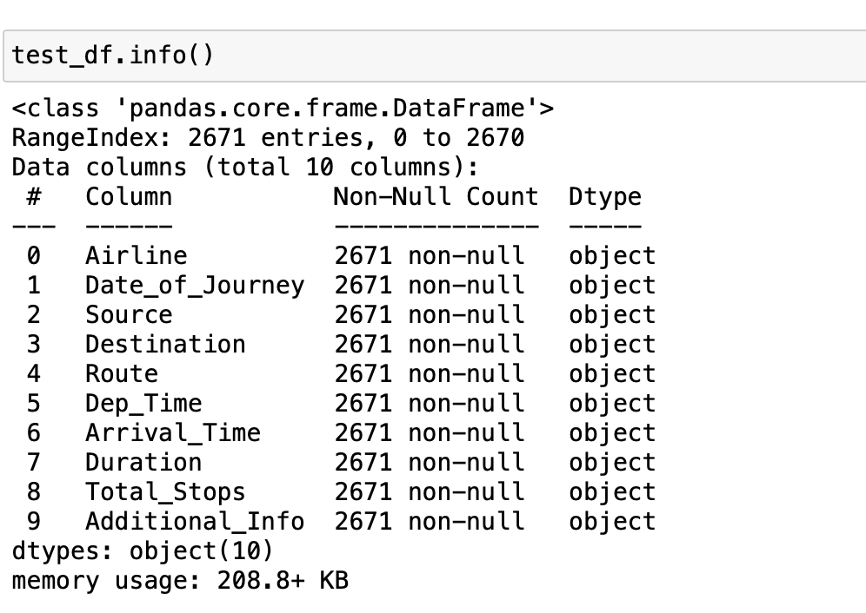
Dataset Information
Data_Train.xlsx
Test_set.xlsx

Slide 5
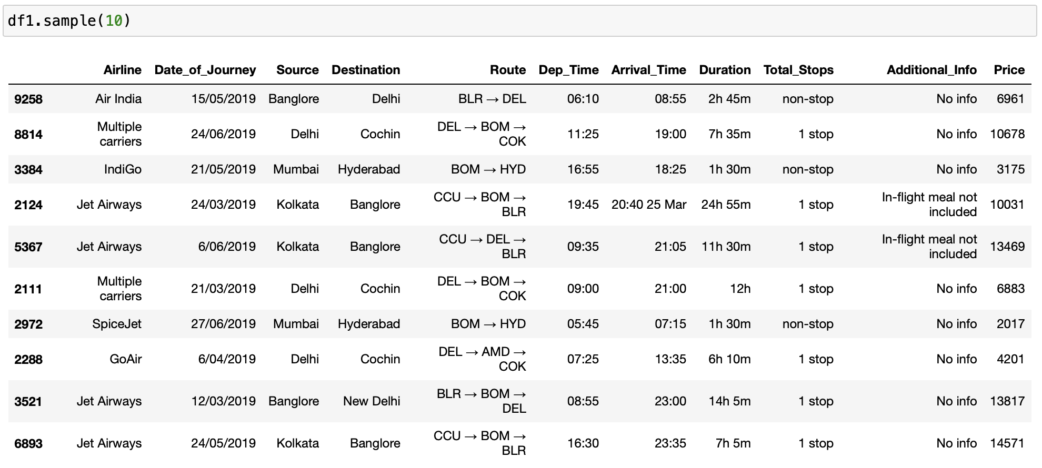
Glimpse of data

Slide 6
Pre-processing/cleaning
The pre-processing steps in both train dataset and test dataset is similar.
Firstly, check for null values , duplicates and drop them.
Converting some rows in dataset to data time format for separating the rows like Date_of_Journey into days and months.
Changing the Arrival_time and Dep_Time into hours and minutes and finally converting the duration into minutes.
Handling some errors like duration of 5m for trip BOM->HYD.
There are two different locations of Delhi and New Delhi but both are same so replacing New Delhi with Delhi.
We will use One-Hot encoding to handle Categorical Data.
We can see Total_Stops variable is an Ordinal Categorical Data so used the Label Encoder here to handle this variable.

Slide 7
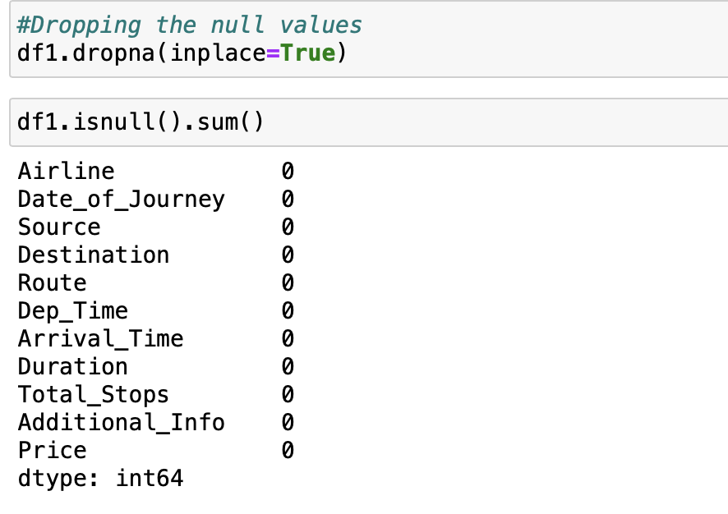
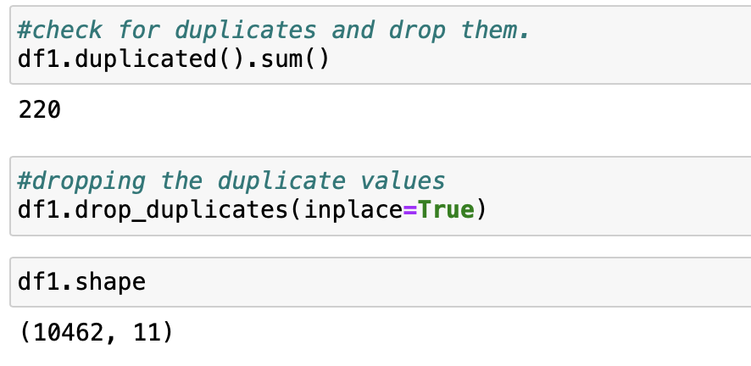
Handling Missing Values and Duplicates

Slide 8
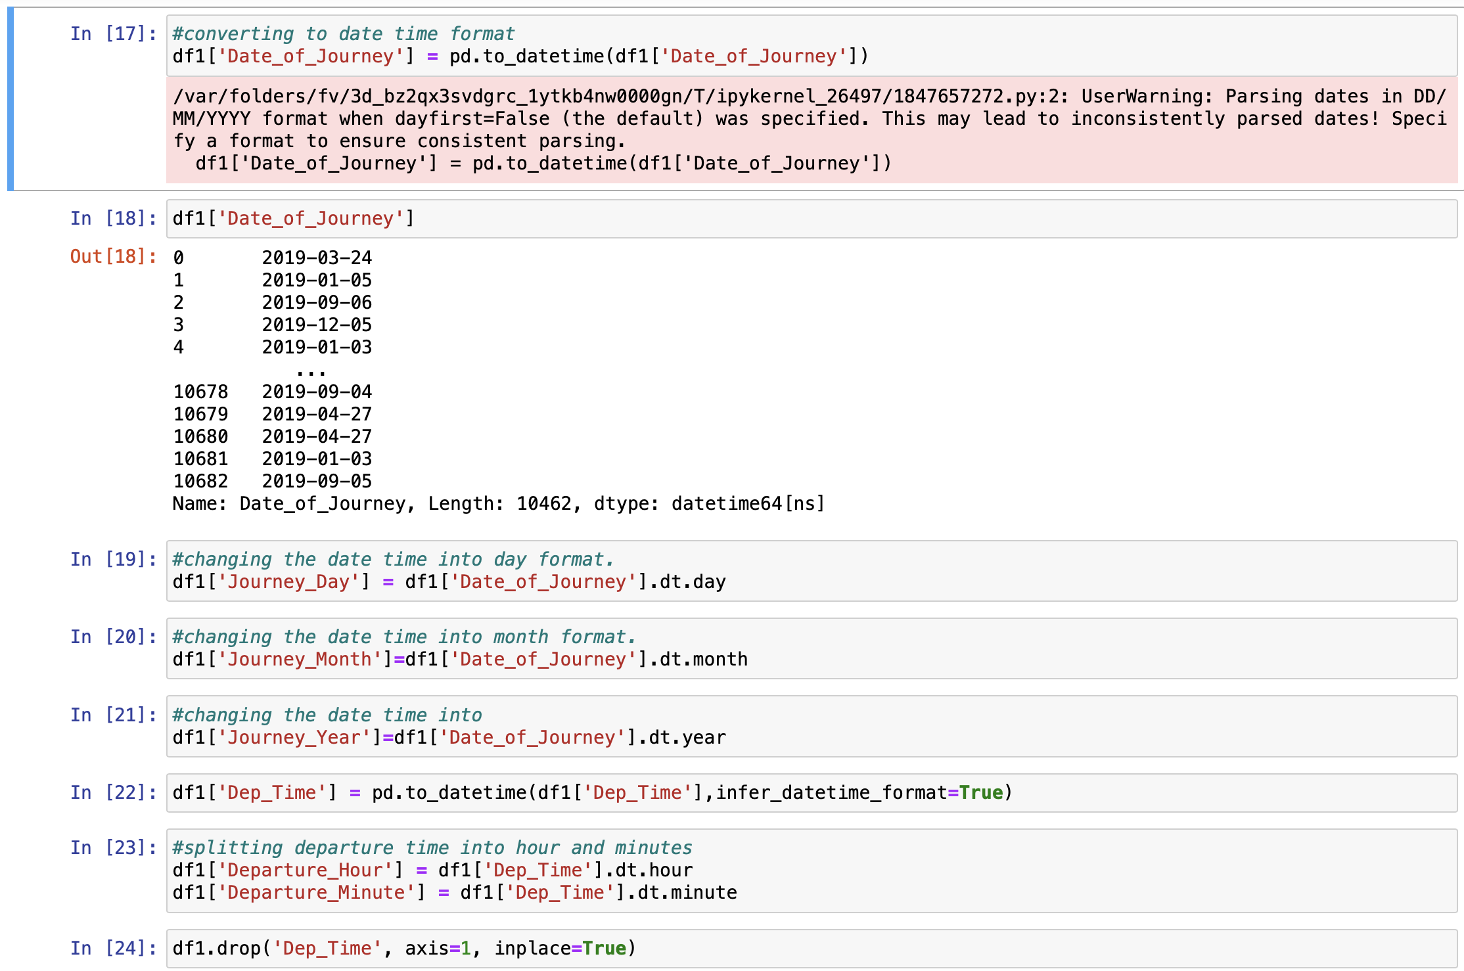
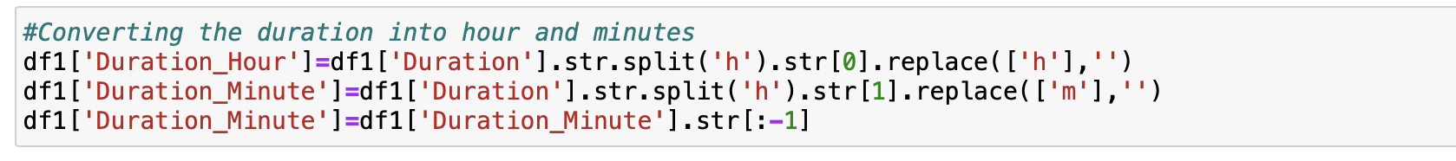
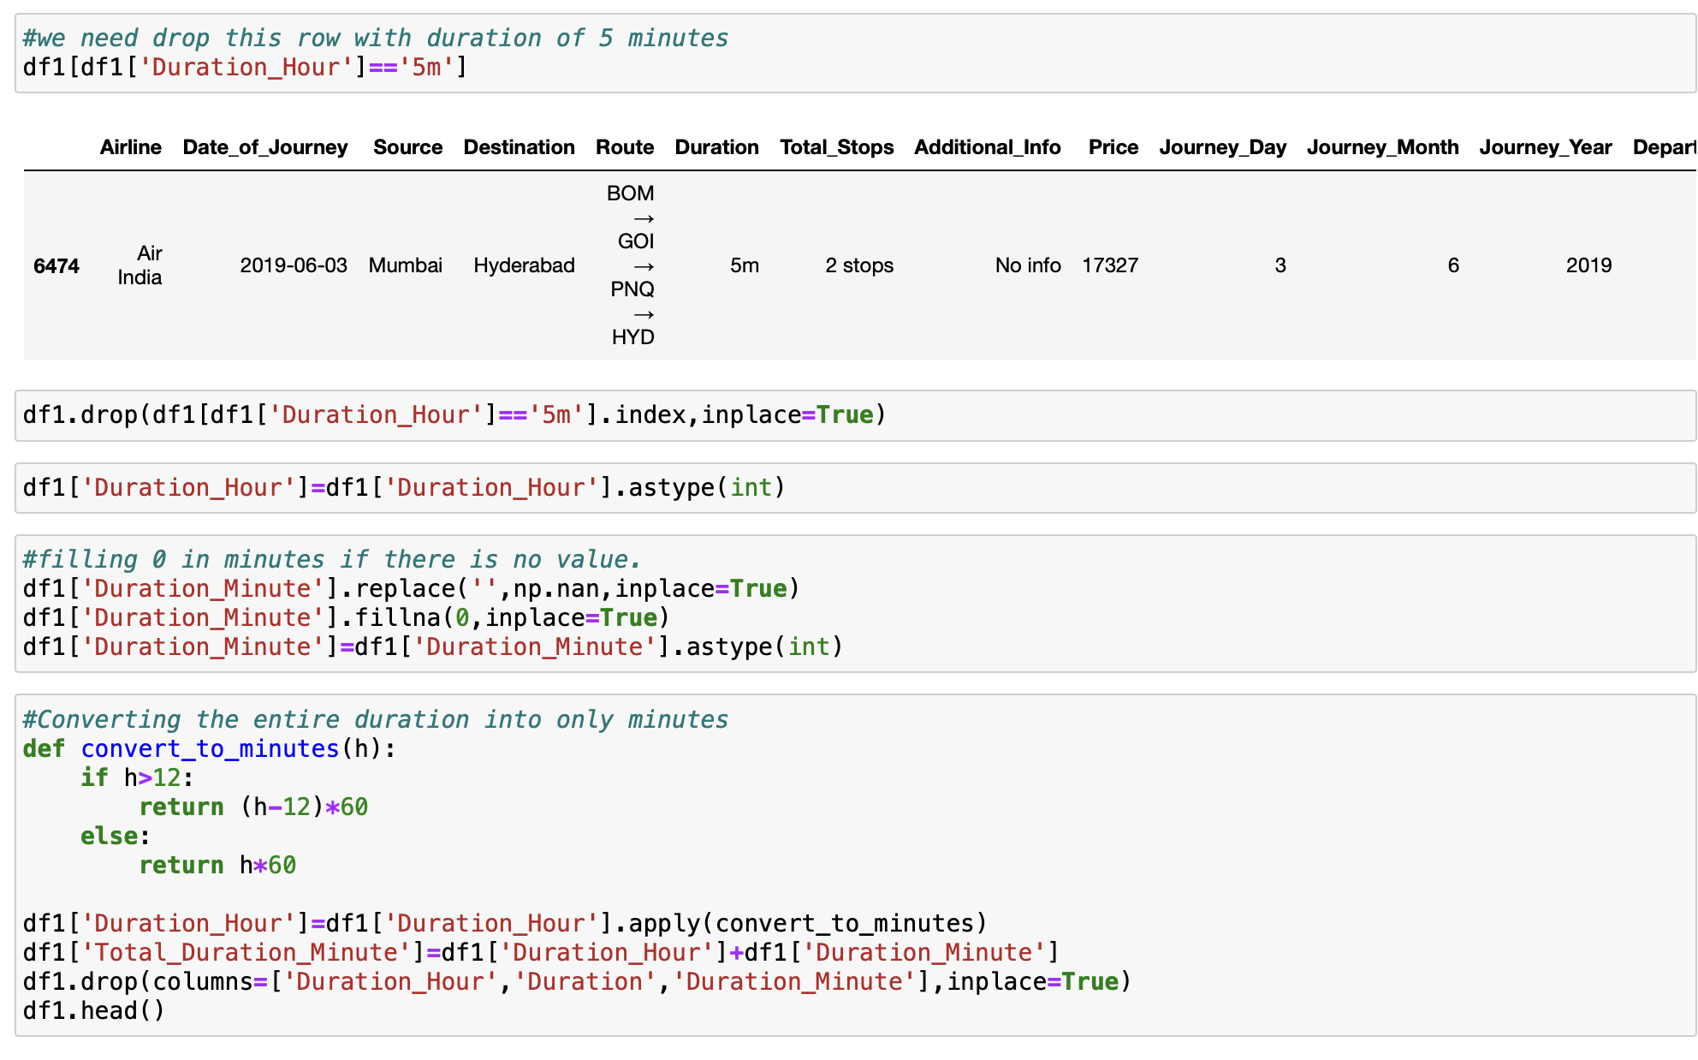
Handling Date and Time Variables

Slide 9
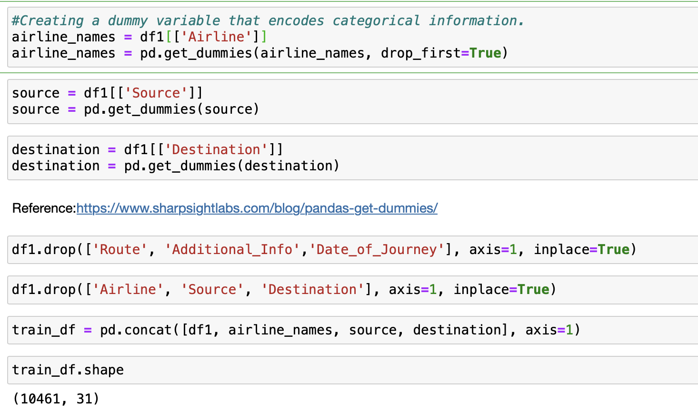
Handling Categorical Data

Slide 10
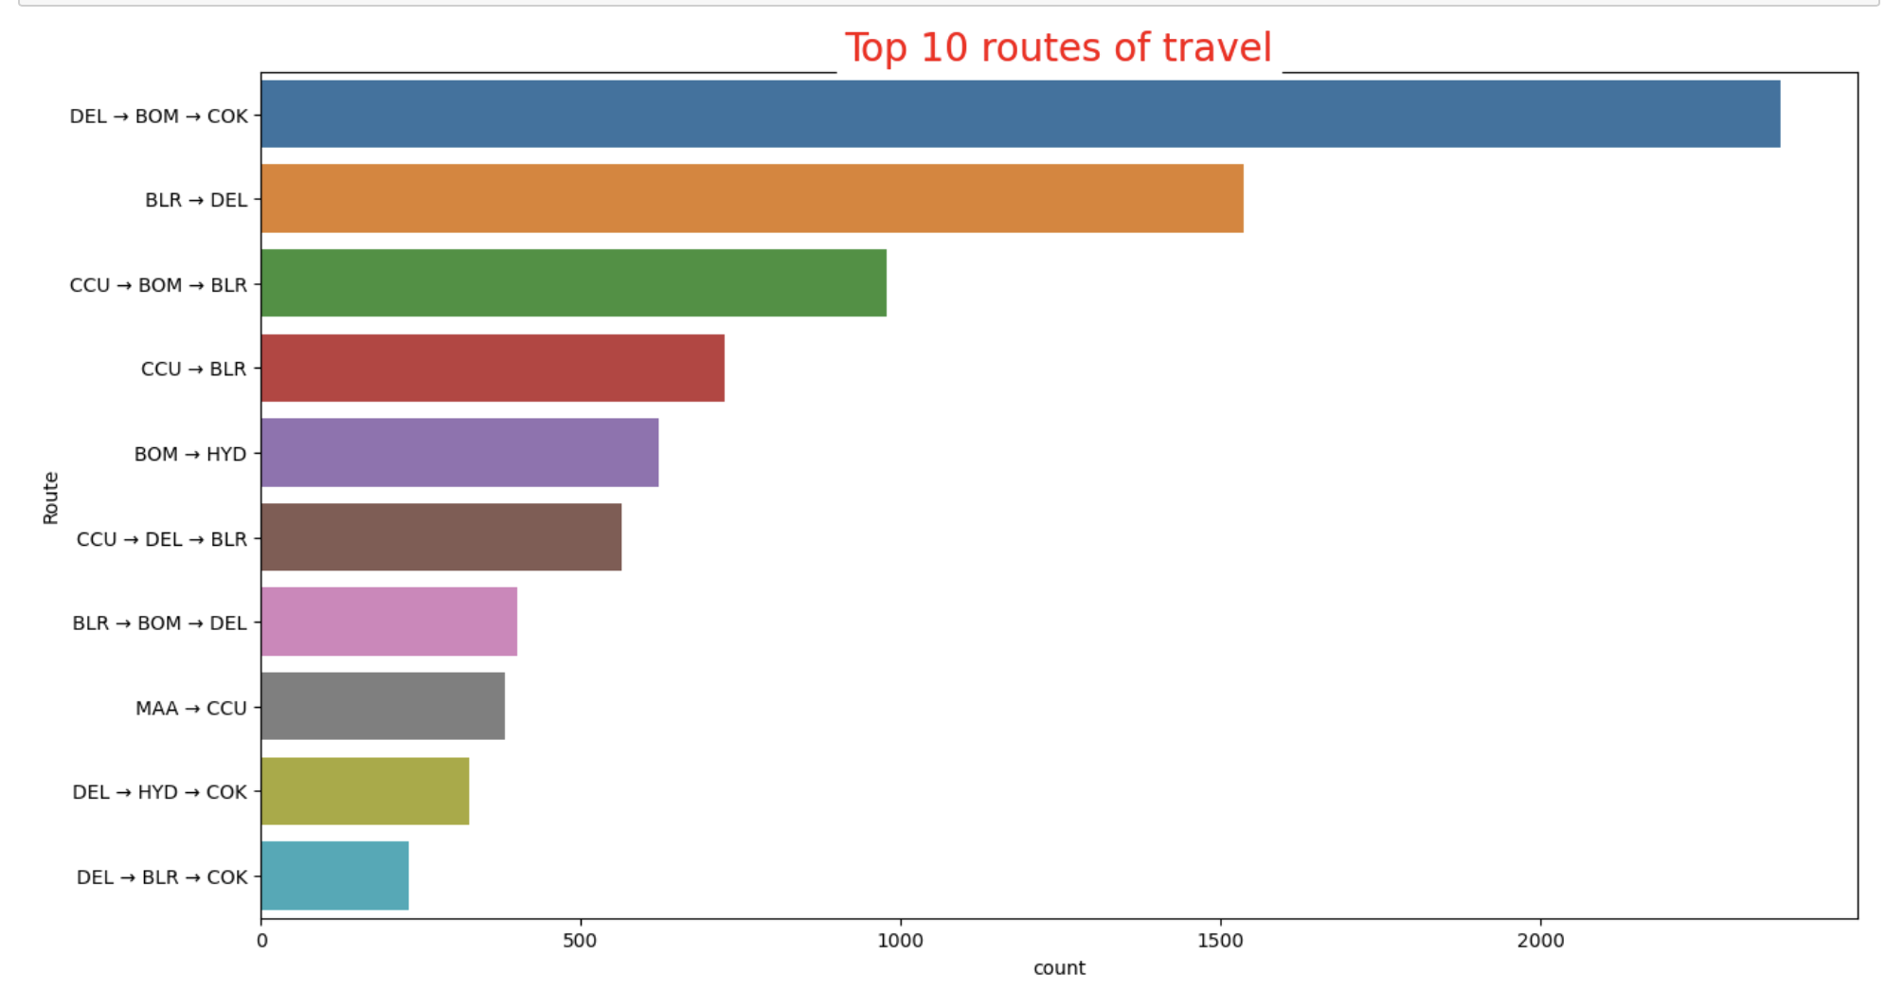
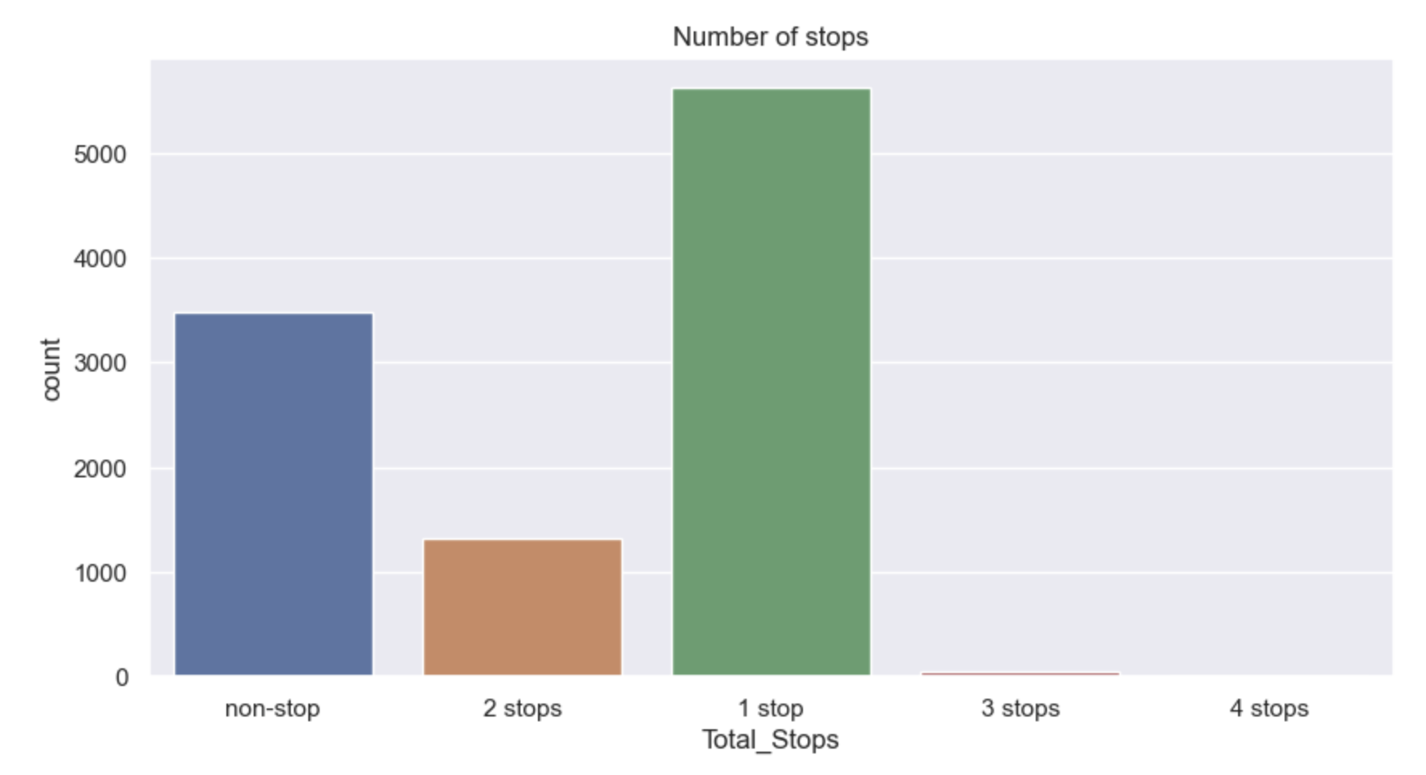
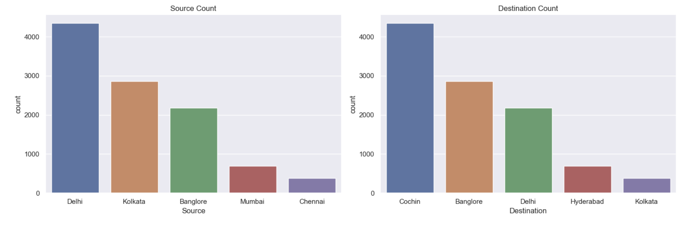
Visualizations and plots

Slide 11
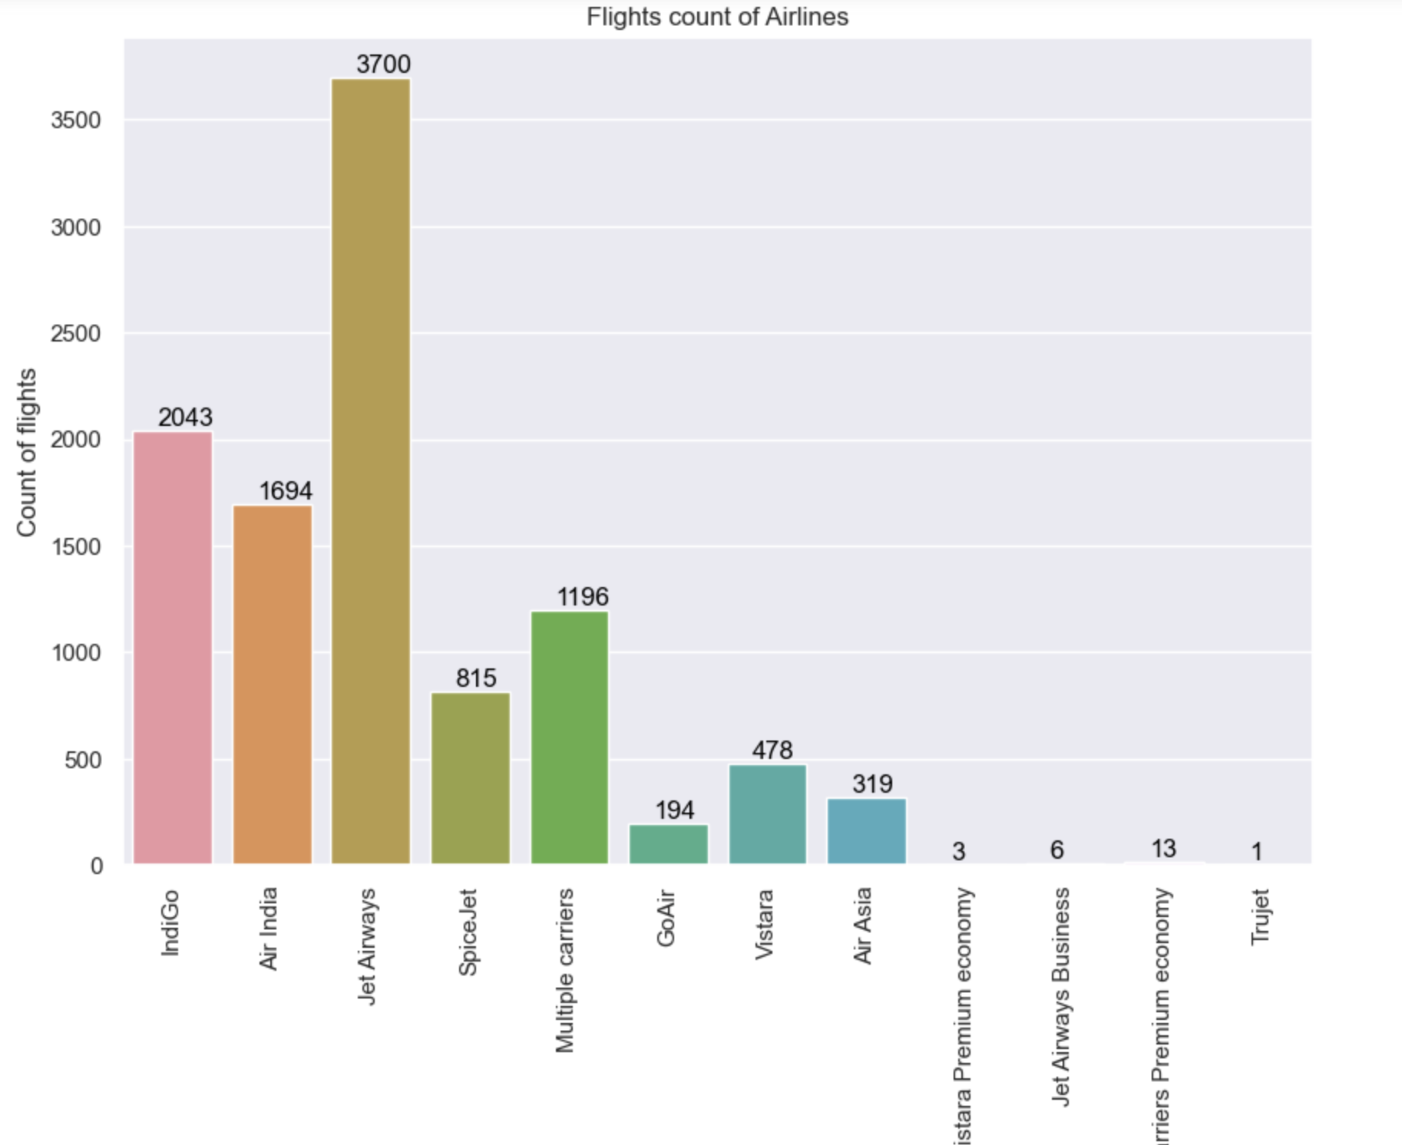
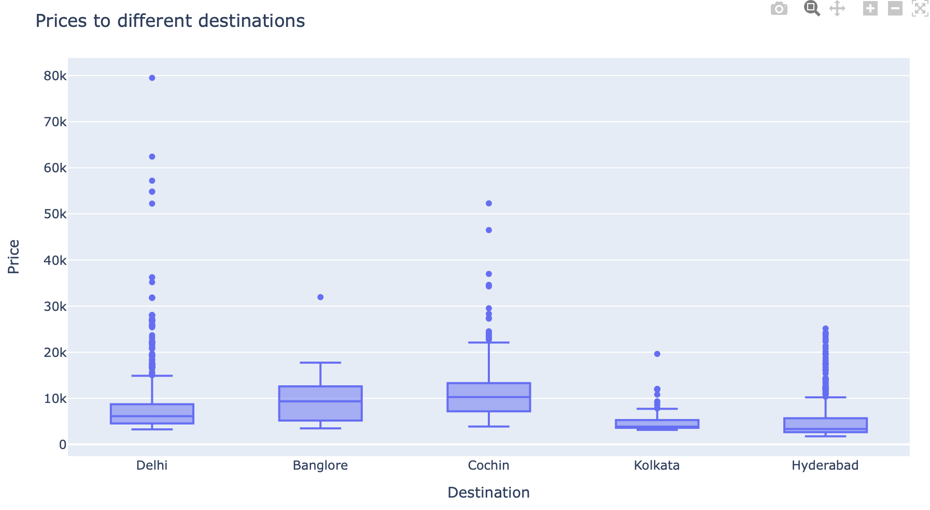
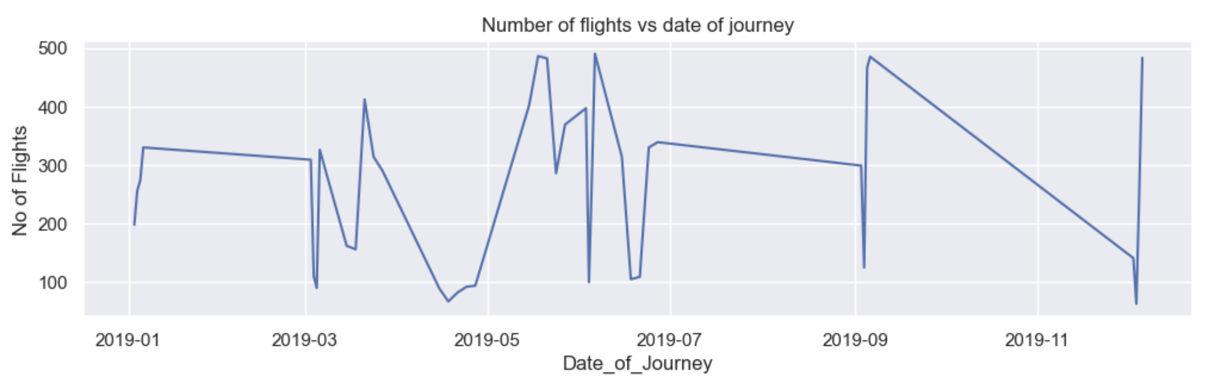

Slide 12
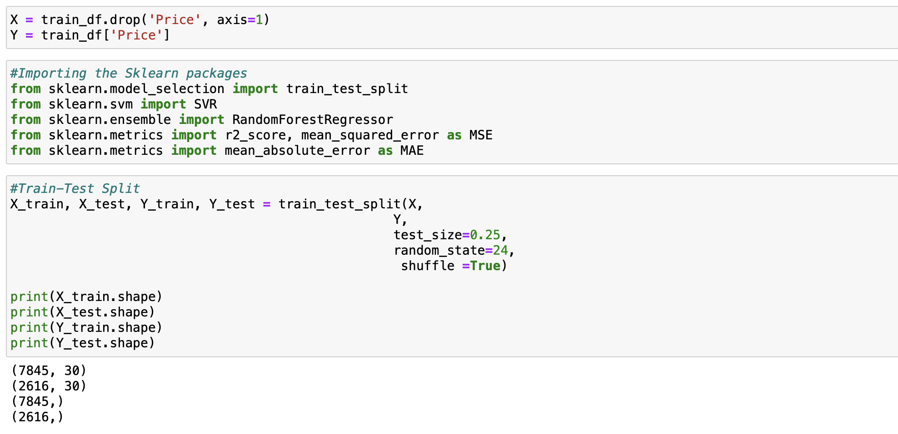
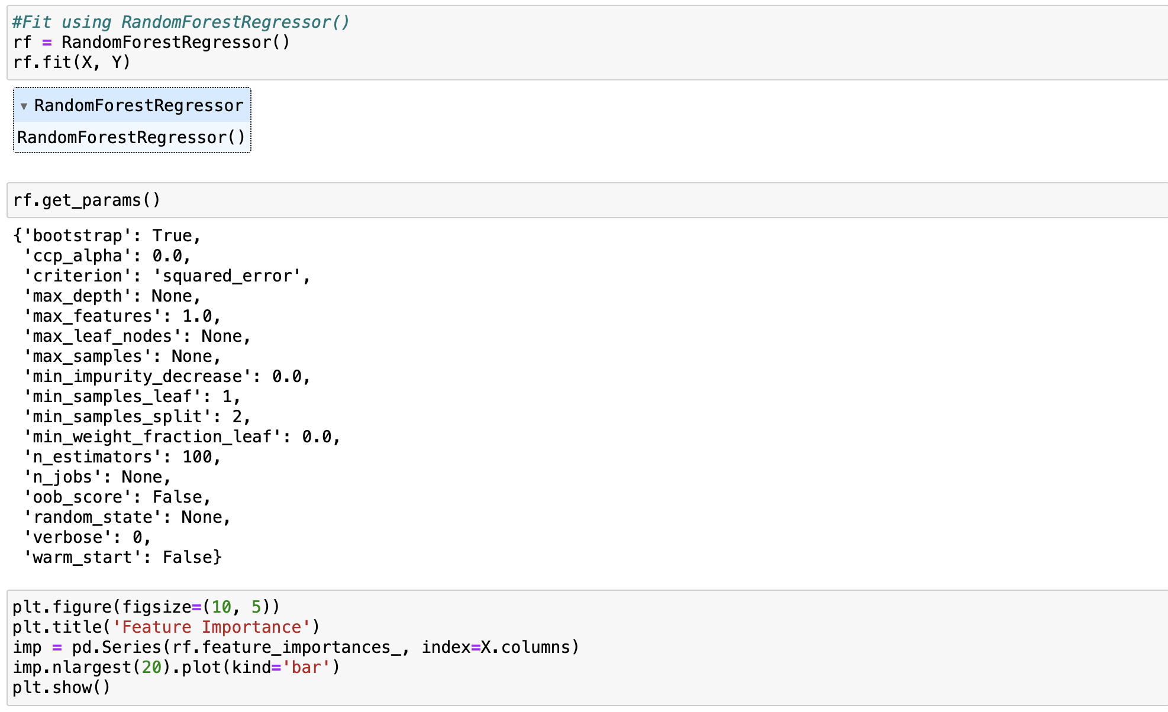
Model Building

Slide 13
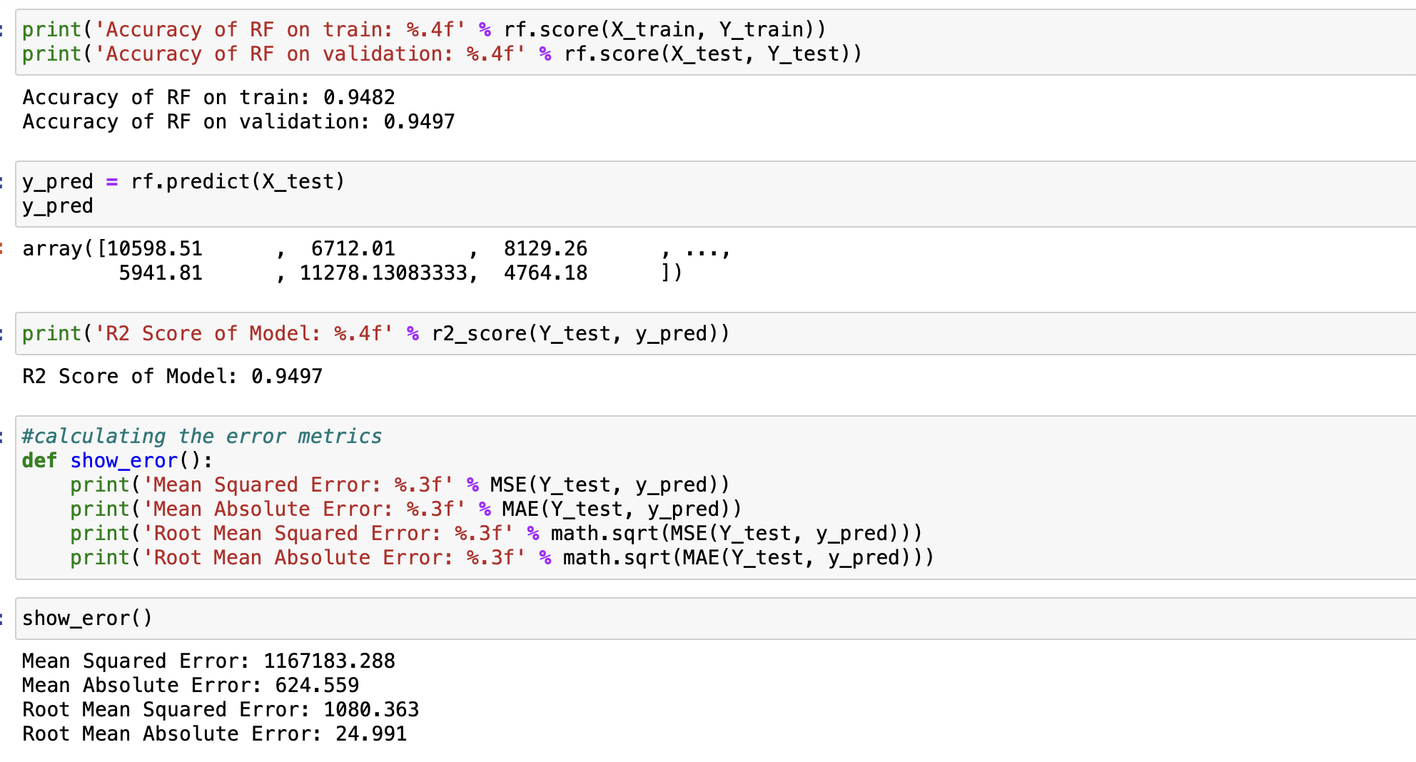
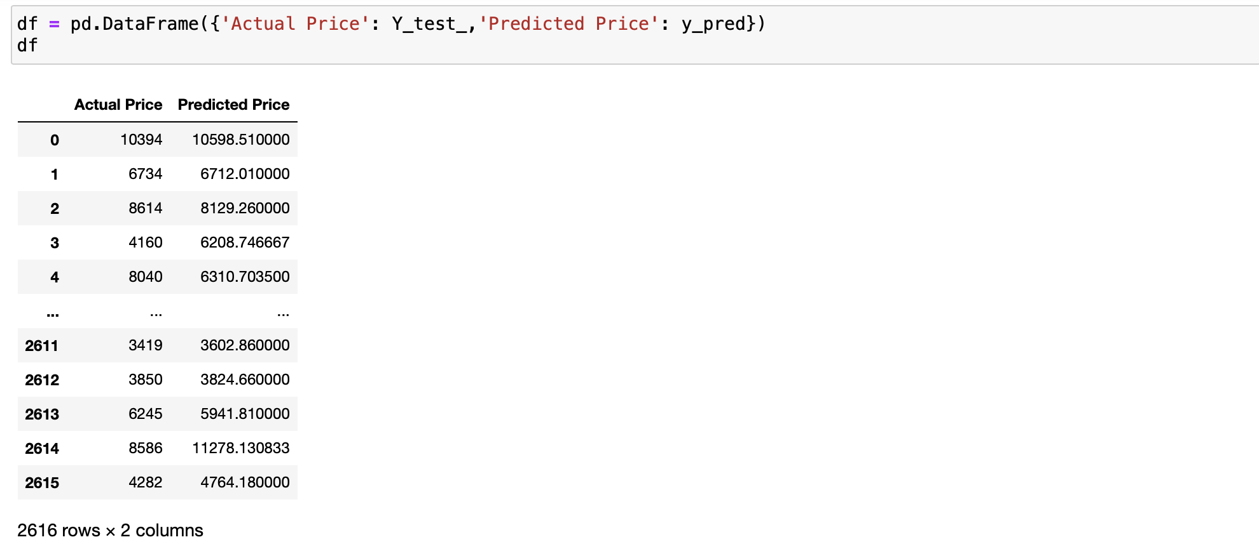
Prediction

Slide 14
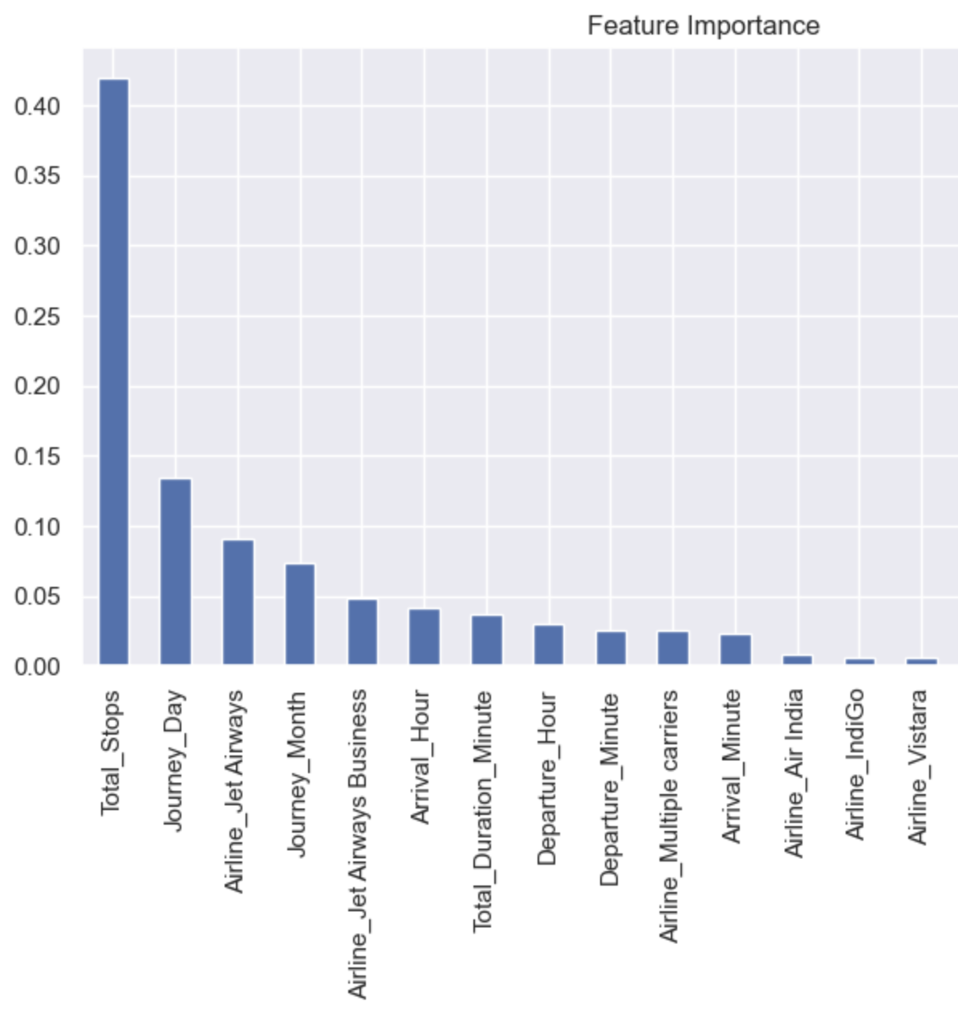
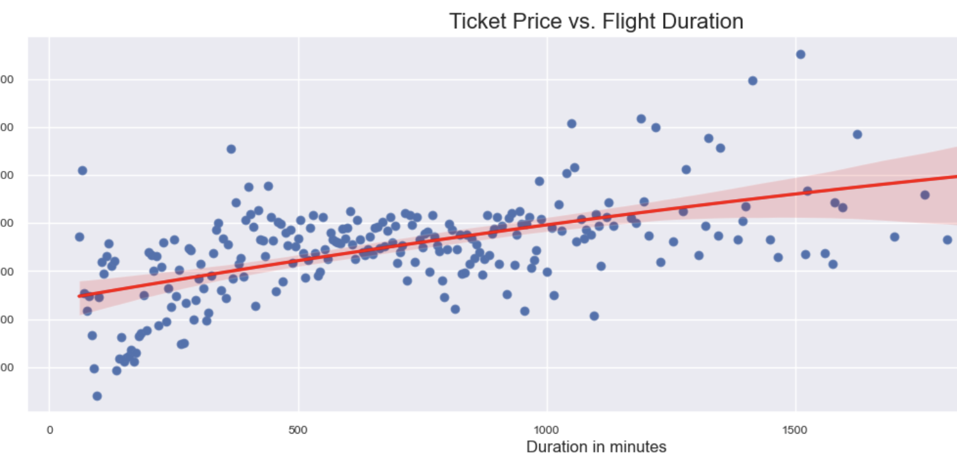
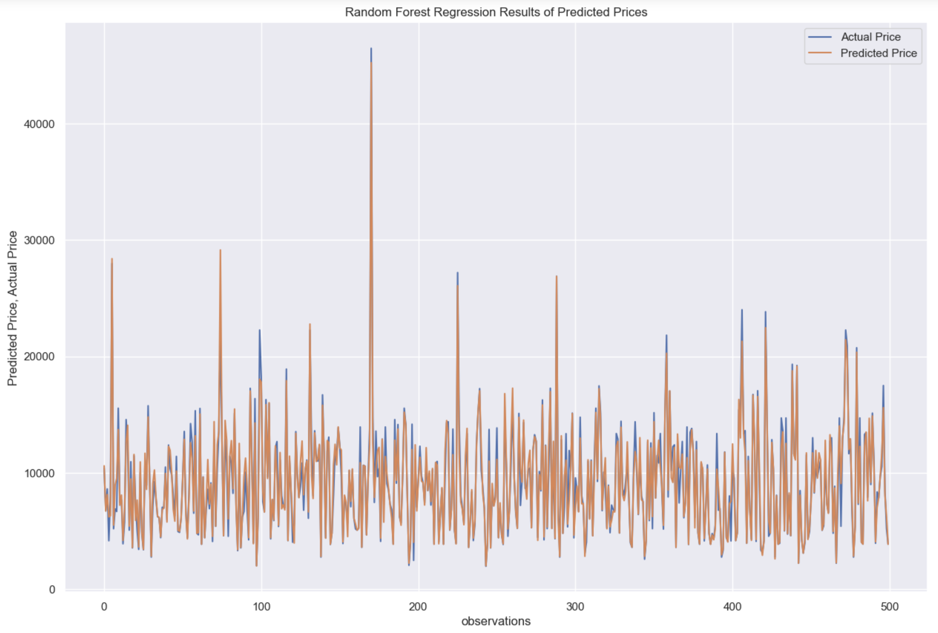

Slide 15
Conclusion and Future work
I have done a complete EDA process, getting data insights, feature engineering, and data visualization.
After all these steps I went for the prediction using machine learning model-making steps.
We can see that the price of the flight depends mainly on number of stops and Day of journey.
I have used Random forest regressor to fit the model.
This model obtained the score of 0.9497
I can try into improve the accuracy by creating multiple models and comparing each of them to get the best prediction possible.
Try prediction using the boosting algorithms.
I need to try creating a model that can produce the less errors.

Slide 16
References
https://www.statology.org/seaborn-subplots/
https://plotly.com/python/box-plots/
https://www.tutorialspoint.com/matplotlib-how-to-show-the-count-values-on-the-top-of-a-bar-in-a-countplot
https://seaborn.pydata.org/generated/seaborn.lineplot.html
https://www.geeksforgeeks.org/python-seaborn-regplot-method/
https://www.sharpsightlabs.com/blog/pandas-get-dummies/
https://scikit-learn.org/stable/modules/generated/sklearn.ensemble.RandomForestRegressor.html

